Slide 1


Exploration of SARS-CoV2
Data Analytics Bootcamp Capstone Project
Notes:
Background Image Citation:
SARS-CoV2 Virus. Adapted from “Transmission of SARS-CoV-2: implications for infection prevention precautions,” by World Health Organization , 2020, July 9, (https://www.who.int/news-room/commentaries/detail/transmission-of-sars-cov-2-implications-for-infection-prevention-precautions). In the public domain

Slide 2




STUDENT TEAM
Bill Remy
Phoenix, AZ
Celeste Moreno-Campoy
Phoenix, AZ
Samuel Guerette
Phoenix, AZ
Joy Arah
Phoenix, AZ

Slide 3
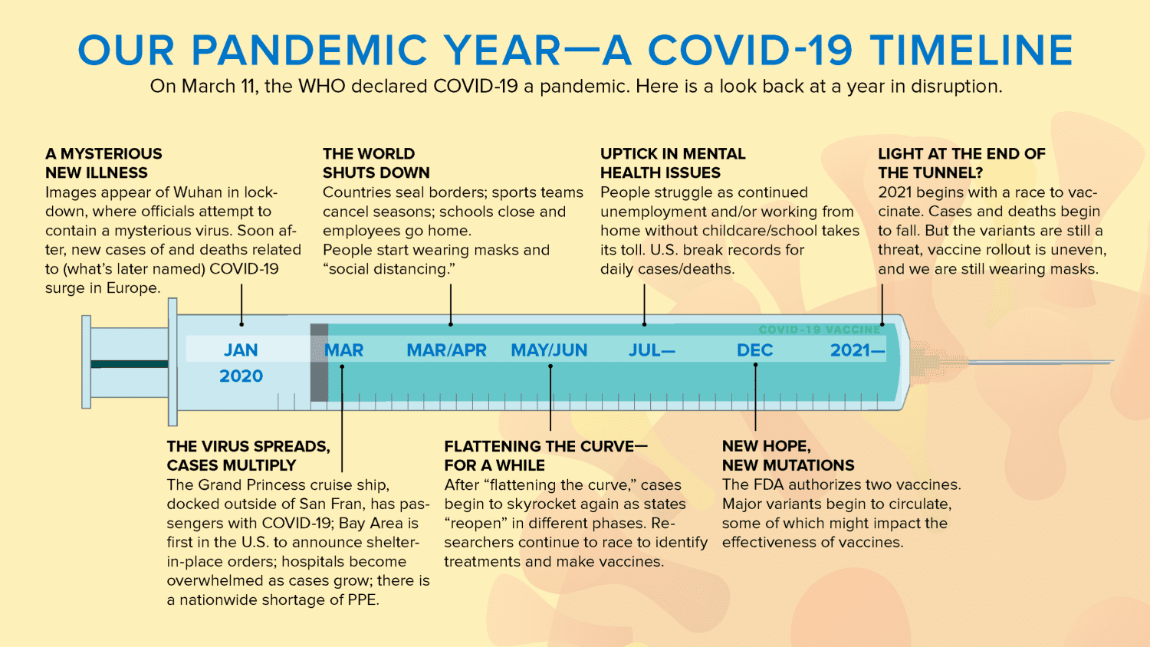
SARS-CoV2 National Impact
Figure 1
Total US cases : 91.6 M (CDC, 2022)
Total US deaths : 1.03 M (CDC, 2022)
Novel variants : Alpha, Beta, Delta, Omicron
Socio-economic downturn:
Food security
Public health
Employment and labour sectors
Education
Healthcare systems
Mental health , etc.
SARVS-CoV2 is the virus that causes the COVID-19 disease.
Note. Adapted from “Our Pandemic Year-A Covid-19 Timeline,” by Katella, K. K., & Szatiai, M. S, 2021, (https://www.yalemedicine.org/news/covid-timeline). In the public domain
Notes:
Reason why: COVID has drastically affected the world, threatening the lives of millions and wreaking havoc on social and economic players. Although COVID-19 has slowly become understood and there have been implementations for disease control, the threat of infectious diseases is still alarming. Throughout the primary years of COVID-19, it became evident that particular locations of the US were heavily affected while others were not. Thus, it is imperative to understand predicting factors and their relationships that may affect both case and death rates. By indicating high-priority areas in the US, one can reallocate resources to those locations and provide further assistance to combat spread. Additionally, this information can be transposed to future implications if another pandemic were to occur in the near future.

Slide 4
Chosen Source Data
US census 2021: https://www2.census.gov/programs-surveys/popest/datasets/2020-2021/counties/totals/
Displays overall population estimates, deaths, births, domestic migration, etc., by county.
Social Context for Understanding a Region: https://www.statsamerica.org/downloads/default.aspx
Gives social context data, such as as measurements of hopefulness, employment rate, conscientiousness, etc. by county data.
Social Vulnerability Index (SVI): https://www.atsdr.cdc.gov/placeandhealth/svi/
Provides estimates of poverty, unemployment, those above 65, disability, etc. by county.
Case Time Series Data - Johns Hopkins University: https://github.com/govex/COVID-19
Displays cumulative cases from 01/01/2020 - 10/03/2021 by US county.
Death Time Series Data - Johns Hopkins University: https://github.com/govex/COVID-19
Displays cumulative deaths from 01/01/2020 - 10/03/2021 by US county.
County Presidential Election Returns 2000-2020: https://electionlab.mit.edu/data-
Provides party affiliation from election returns at a county level.
County Hospital Data: https://hifld-geoplatform.opendata.arcgis.com/datasets/geoplatform::hospitals/about
Gives insight to total number of beds available in hospitals within the county level.

Slide 5
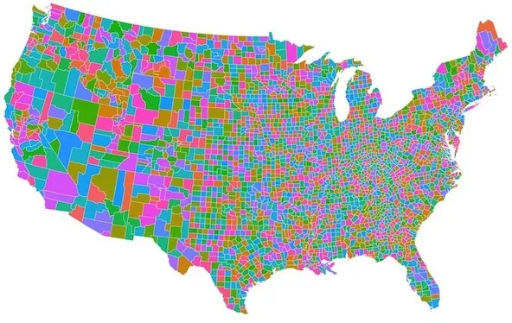
Investigation of COVID-19 Goal
Figure 2. US Counties
Question to be Answered
Which counties are within the top 10% of worst case rates?
Which counties are within the top 10% of the worst death rates?
Which features in the dataset have the highest contribution towards case and death rates?
Our Goal
Utilize county population demographics, vulnerability data, death/case series rates, election data, hospital data, and social context information in order to predict low performing counties over the primary year of COVID-19 (March 2020 - March 2021).
Predict priority high risk (top 10%) counties for reallocation of resources.
Notes:
County Picture: Stock photo and does not require reference by APA standards

Slide 6
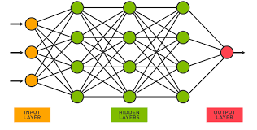
Chosen Language & Technology
Coding Language: Python
Visualization: Tableau and Jupyter Notebook (Pandas)
Database: AWS, Postgres
Machine Learning: Neural Network (NN)
Why NN ?
Contains the ability to learn by themselves and produce the output that is not limited to the input provided to them.
Even if a neuron is not responding or a piece of information is missing, the network can detect the fault and still produce the output.
They can perform multiple tasks in parallel without affecting the system performance.
Drawbacks of NN
Not able to generalize from limited training data.
On smaller datasets, neural network models tend to overfit.
They memorize the training data and don't generalize well to new examples.
Figure 3. Neural Network. Adapted from “What is a Neural Network?” by TIBCO, 2022, (https://www.tibco.com/reference-center/what-is-a-neural-networ). In the public domain

Slide 7
Tools Used Throughout the Project
Jupyter Notebook
Web-based platform for interactive computing
Pandas
High level building block for analysis
Scikit-Learn
Robust machine learning library including classification, regression, cluster, etc.
Matplotlib
Cross-platform, data visualization and graphical plotting library
Seaborn
Built on top of matplotlib, used for data visualization and exploratory data analysis
Sqlalchemy
Library that facilitates the connection and communication between the database and jupyter notebook
SMOTEENN
Combination of over and under sampling method that is valuable for imbalance data
Numpy
Performs a variety of mathematical operations
Tensorflow
Library for high performance numerical computation
Psycopg2
Used to perform operations on PostgreSQL using python, it is designed for multi-threaded applications
Tableau
Public data visualization tool that provides pictorial and graphical representation of data

Slide 8
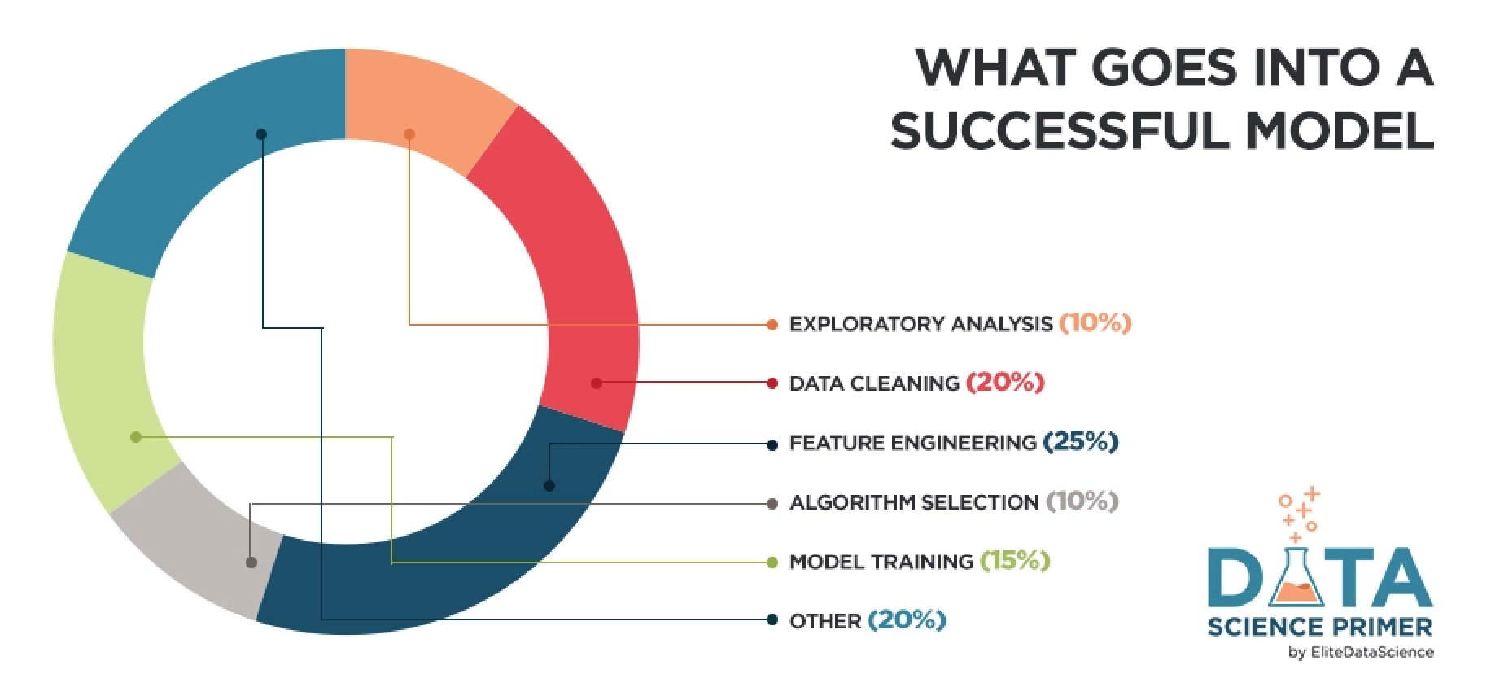
Phases of COVID-19 Model
Data Exploration
Data Preprocessing
Uncover initial patterns & characteristics
Begin to uncover data feature importances
Create visualizations
Data Analysis
Final pre-processing
Model planning
Solidify feature importances
Explore multiple models
Modeling Building
Establish best ML model
Optimize Model
Communicate Results
Create final visualizations
Figure 4. Machine Learning Process. Adapted by “Feature Engineering for Machine Learning” by Elite Data Science, 2022, July 14,( https://elitedatascience.com/feature-engineering). In the public domain

Slide 9
Phase 1 : Data Exploration
Preparing Data (AWS & Postgres)
Data cleaning
Data transformation
Data reduction
Utilized Tableau and Jupyter Notebook to create visual analytics and search for valuable insights of all individual and merged datasets. This included overall patterns and characteristics of the data.
Two merged datasets: COVID cases & COVID deaths
Implemented correlation matrices and regressions to begin the evaluation of feature importances.
If a particular dataset did not present adequate information, it was necessary to drop inadequate datasets and explore more suitable options.
Established High risk counties: >= 0.9 quantile + 2 std. deviations

Slide 10
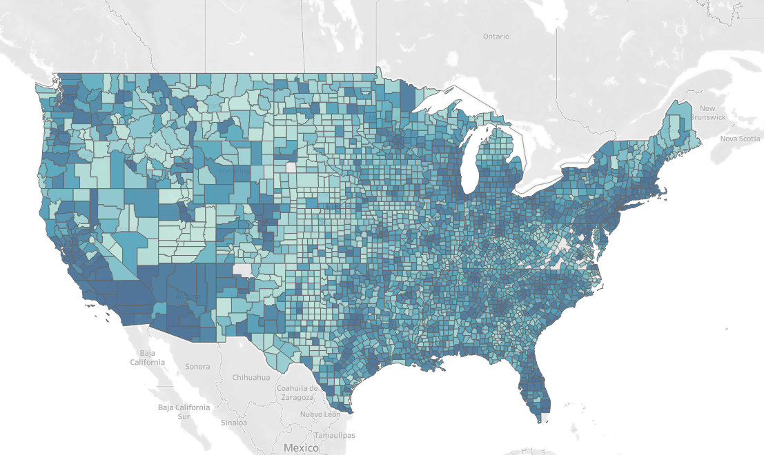
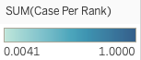
Percentile Ranking of Cases by County : March 2020 - March 2021
Figure 5. Tableau COVID-19 Case Ranking

Slide 11
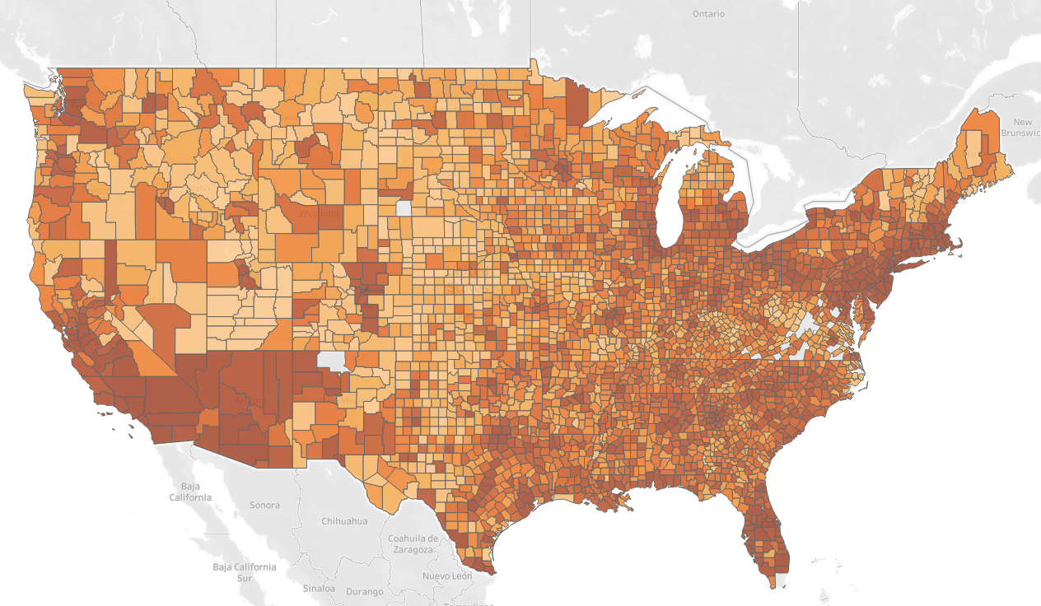
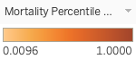
Percentile Ranking of Deaths by County : March 2020 - March 2021
Figure 6. Tableau COVID-19 Death Ranking

Slide 12
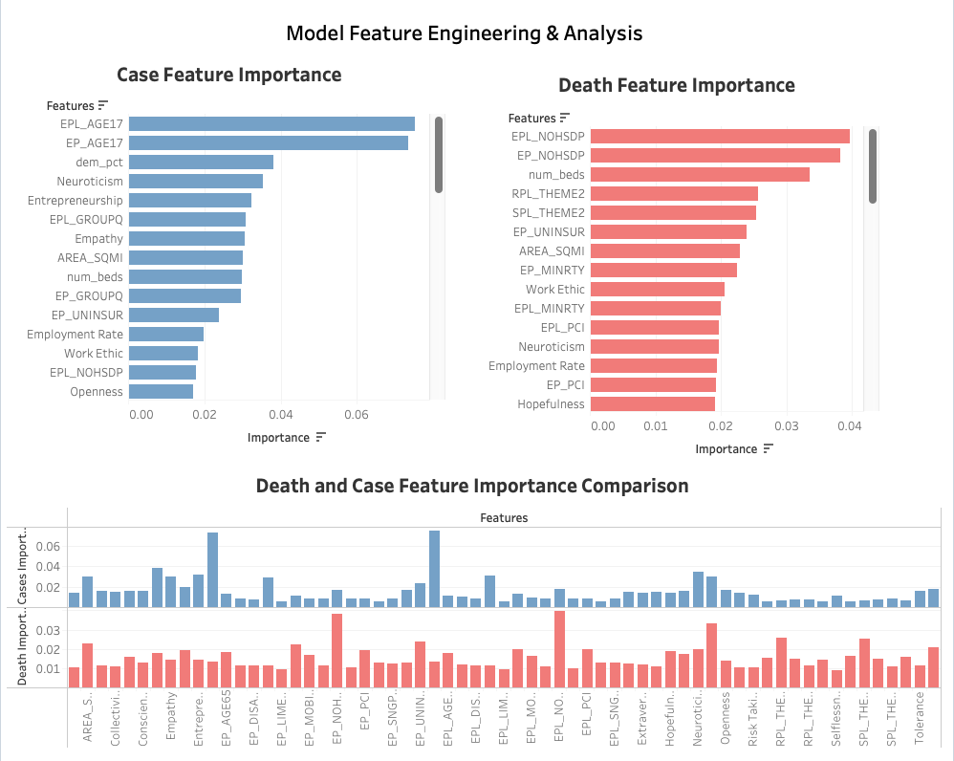
Initial Model Feature Engineering & Analysis
Figure 7. Tableau COVID-19 Feature Importance
Total of 63 features included
Top three features:
Cases:
Population <= 17 yrs
Democrat voting percentile
Neuroticism
Deaths:
Persons with no high school diploma (age 25+)
Number of hospital beds
Household composition
Notes:
Dropped redundant SVI data percentile columns and features not within the project scope

Slide 13
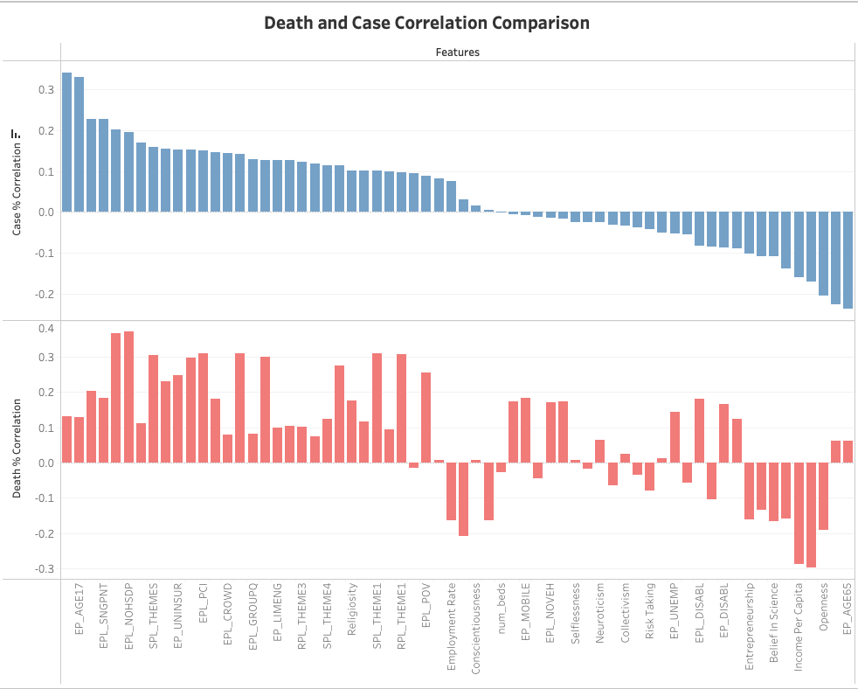
Phase 2: Analysis
Figure 8. Tableau COVID-19 Feature Correlation
Connected to final AWS database
Initial preprocessing and joining of data
Joined datasets to their appropriate tables
Further preprocessing in jupyter
Data transformation and reduction
Feature Engineering
Utilized logistic regression for feature importance and correlation matrices
Sub-optimal features were dropped based on their importance and how they impacted the ML results

Slide 14
Phase 2: Analysis
Evaluated various ML models
Neural Network (initial choice)
Unsatisfactory recall and an accuracy of ~ 78%
Linear Regression
Poor accuracy and recall rate
Random Forest Classification
Poor recall and accuracy
Random Forest Logistic Regression (RFLR)
Explored hyper-tuning parameters to avoid overfitting data
Resulted in high accuracy of ~ 98-99% , but exhibited sub-optimal recall
XGBoost Regression
Similar results compared to RFLR
Determined one of our datasets (SVI Dataset) may be causing ML difficulties
Removed SVI dataset completely and integrated Census Bureau's Community Resilience Estimates dataset
The Community Resilience Estimates use American Community Survey microdata and Population Estimates Program data to measure the capacity of individuals and households to absorb the external stresses of the impacts of a disaster.
Explored Random Forest SMOTEENN Classification Model for new dataset
Notes:
Convert ML models to table ??

Slide 15
SMOTEENN CLASSIFICATION
Combination of:
SMOTE’s ability to generate synthetic examples for minority class
ENN’s ability to delete observations from both classes that are identified as having different classes between the observation’s class and its K-nearest neighbor majority class.
Benefits:
Effective in solving issues correlating with imbalance data
Higher performance compared to original SMOTE
Implementation of over and under sampling
Drawbacks:
Increased likelihood of overfitting during oversampling
Losing majority class data points in order to balance data during undersampling

Slide 16
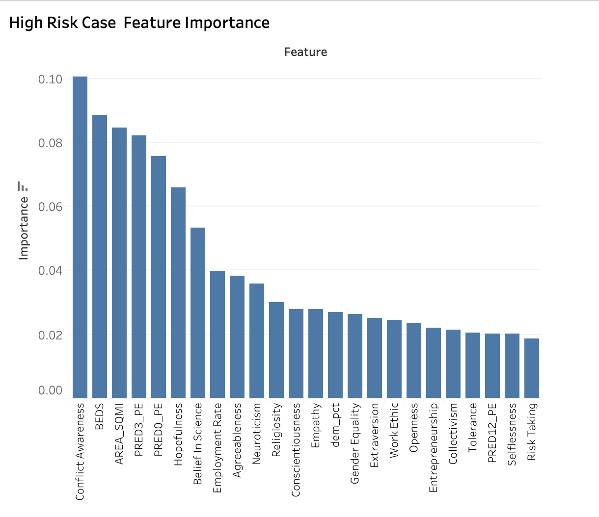
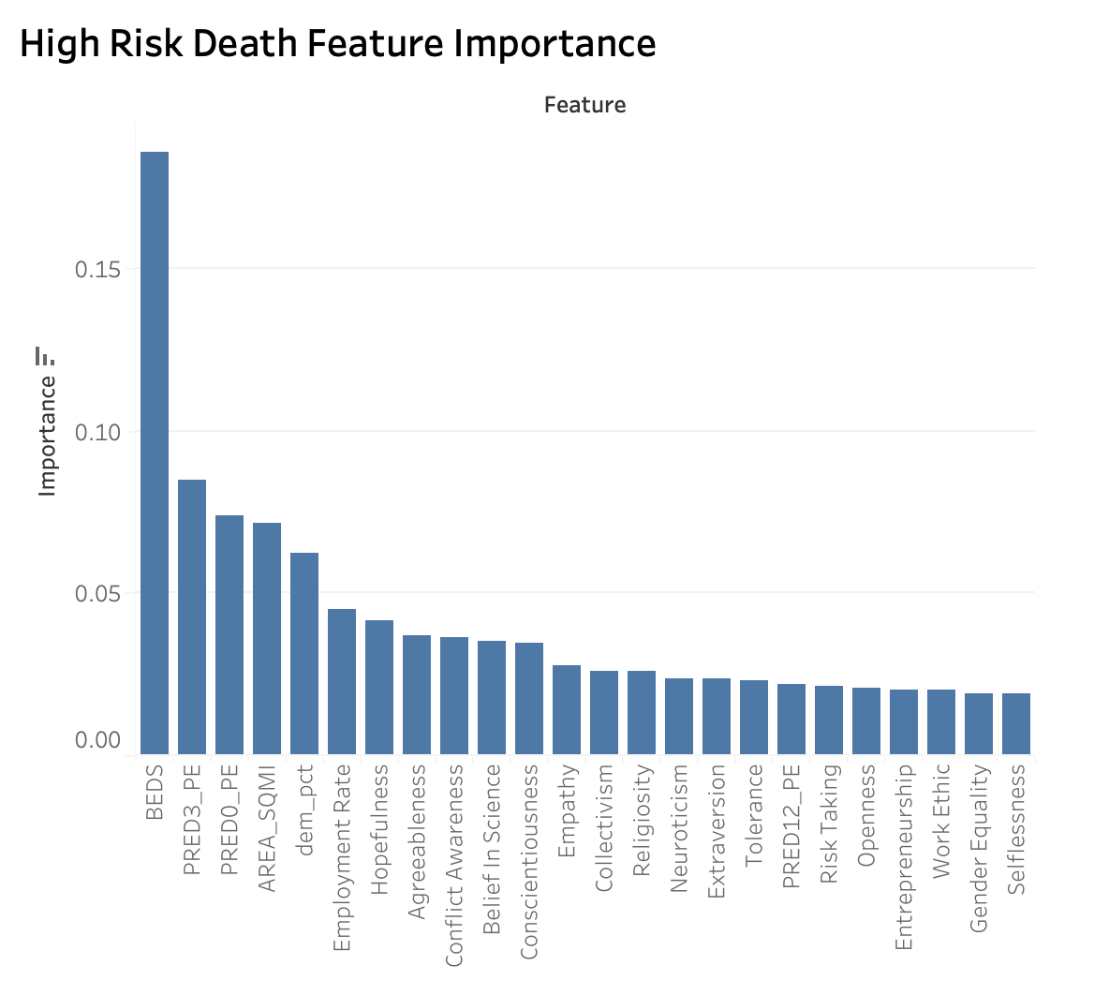
SMOTEENN Model Feature Engineering & Analysis
Total of 24 Features
Figure 9. Tableau COVID-19 SMOTEENN Case Feature Importance
Figure 10. Tableau COVID-19 SMOTEENN Death Feature Importance

Slide 17
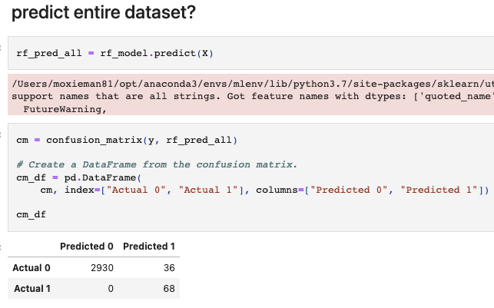
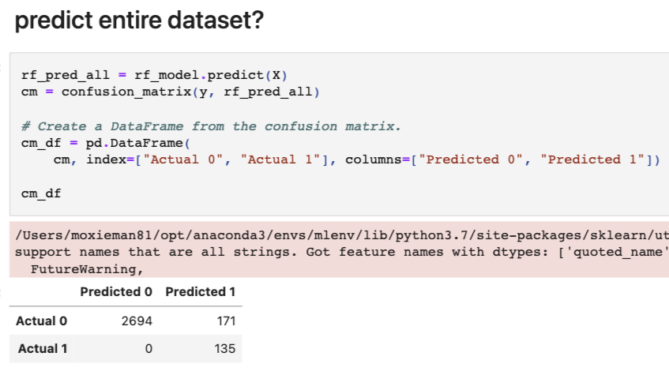
Results of SMOTEENN Classification
RFC Code: https://github.com/sdguerrette/capstone_project
COVID-19 Cases
COVID-19 Deaths
Figure 11. Jupyter SMOTEENN COVID-19 Case Results
Figure 12. Jupyter SMOTEENN COVID-19 Death Results
Notes:
** Will go to code in github to explain the SMOTEENN process **

Slide 18
Results of SMOTEENN Classification
 | Cases | Deaths
Sensitivity | 1.0000 | 1.0000
Specificity | 0.6538 | 0.4412
Precision | 0.9879 | 0.9403
Negative Predictive Value (NPV) | 1.0000 | 1.0000
False Positive Rate | 0.3462 | 0.5588
False Discovery Rate | 0.0121 | 0.0597
False Negative Rate | 0.0000 | 0.0000
Accuracy | 0.9881 | 0.9430
F1 Score | 0.9939 | 0.9692
Matthews Correlation Coefficient | 0.8037 | 0.6441

Slide 19
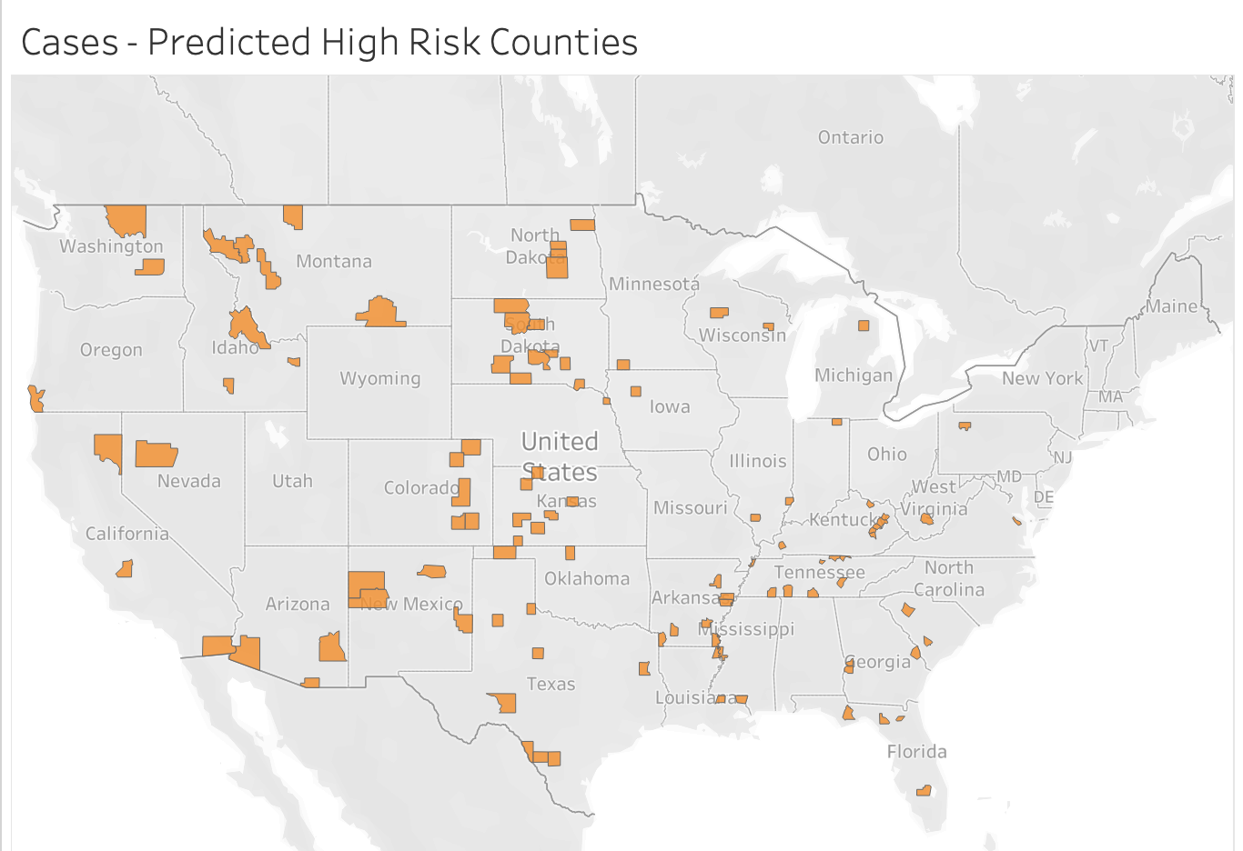
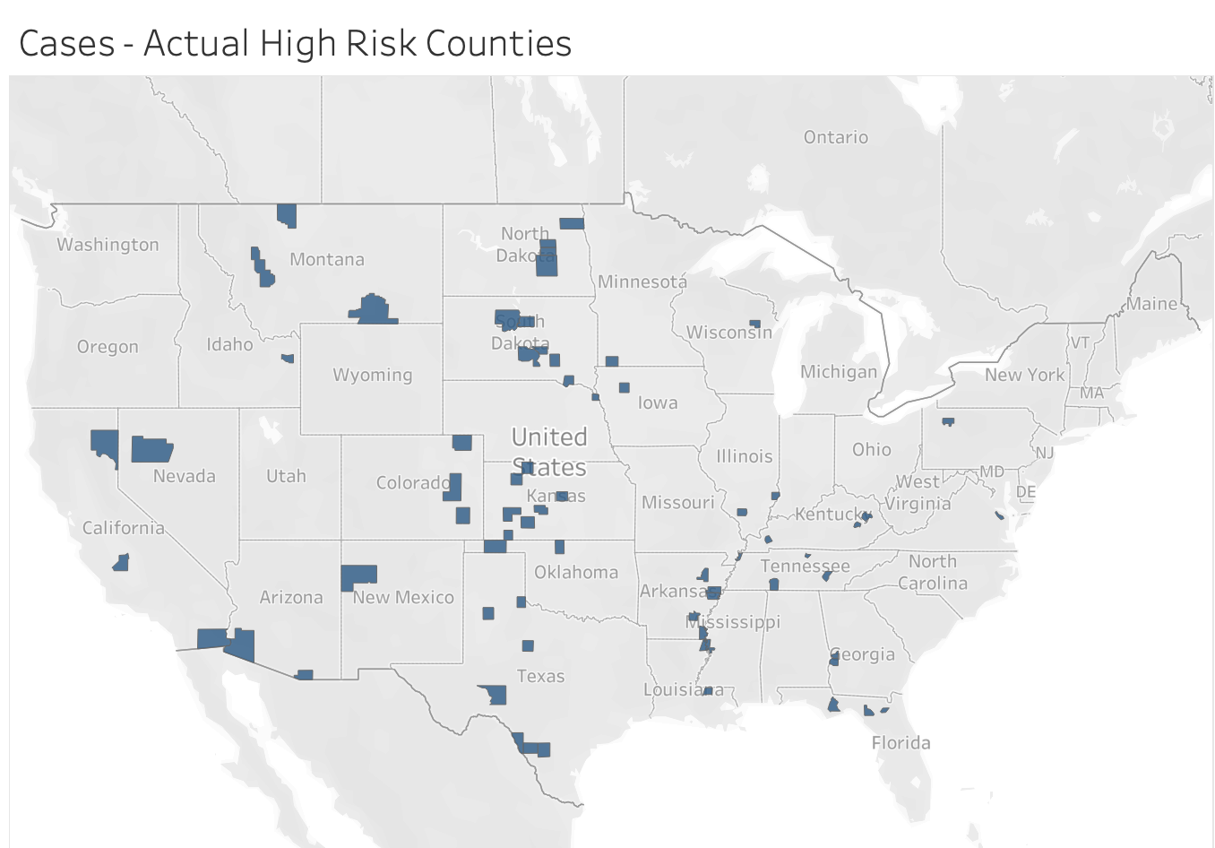
Cases by County : Actual vs. Predicted
Figure 13. Tableau SMOTEENN COVID-19 Predicted High Case Results
Figure 14. Tableau SMOTEENN COVID-19 Actual High Case Results

Slide 20
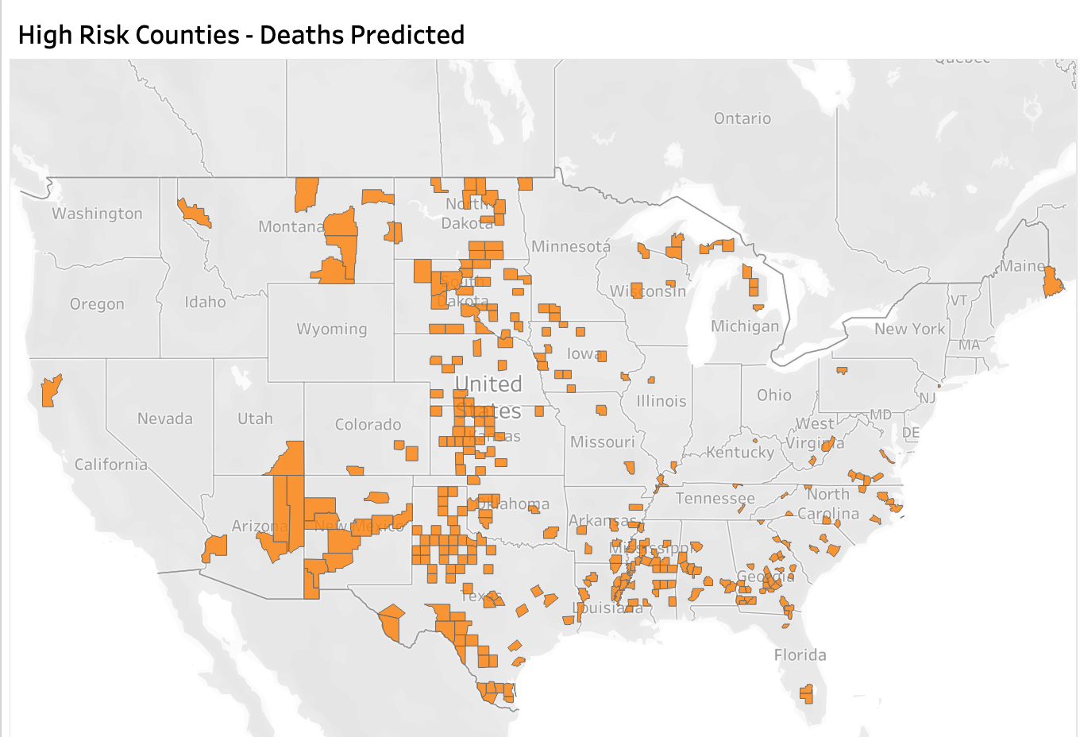
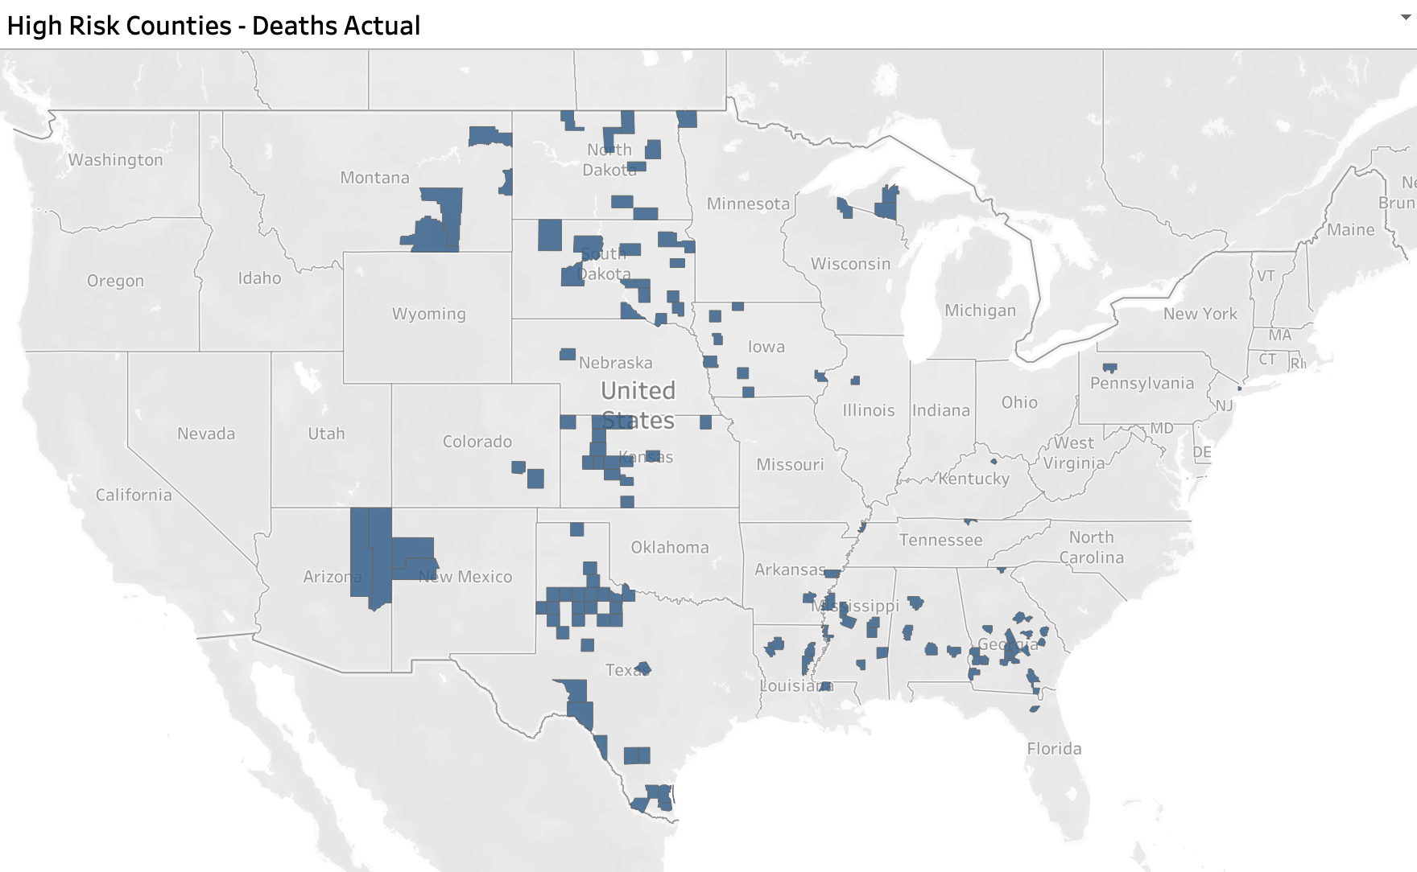
Deaths by County : Actual vs. Predicted
Figure 15. Tableau SMOTEENN COVID-19 Predicted High Death Results
Figure 16. Tableau SMOTEENN COVID-19 Actual High Death Results

Slide 21
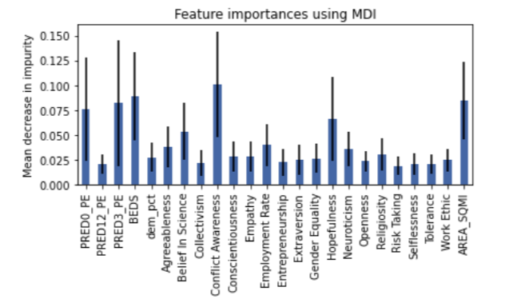
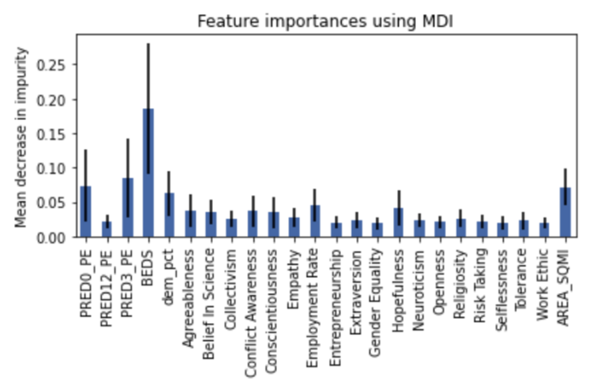
Top Influential Features of SMOTEENN Models
Figure 17. Jupyter Feature Importances for Cases SMOTEENN Model
Top three features:
Cases:
Conflict awareness
Hospital beds
Area per Square Mile (SQMI)
Six total features were found to have significant influence
Deaths:
Hospital beds
Rate of individuals with three plus risk factors
Rate of individuals with zero risk factors
Hospital beds is the primary feature, all others are significantly less important
Figure 18. Jupyter Feature Importances for Deaths SMOTEENN Model

Slide 22
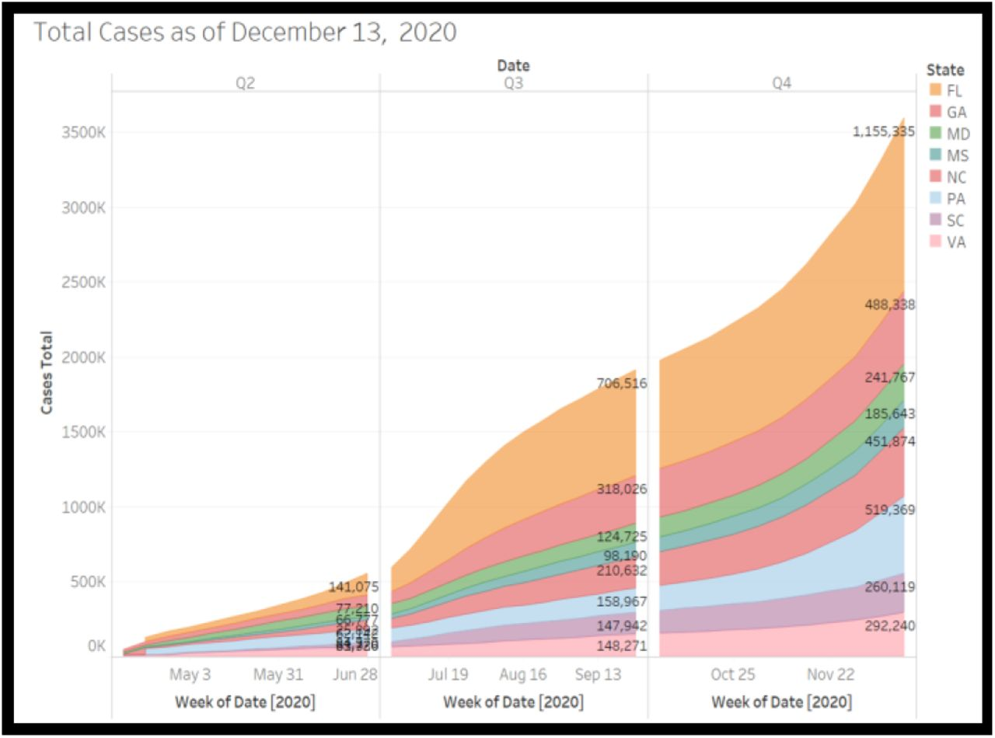
Recommendations for Future Analysis
Integrate a time series analysis to view quarterly, monthly, and daily differences at the county and state level.
This can provide insight if there are any feature importance changes that are dependent on the time-frame.
Add weather data in conjunction with time series
Possibility weather can contribute to case and death rates
Include vaccination data at state and county level
Can provide insight if complete vaccination or lack of vaccination contributed to case and death rates.
Going further, one can view if a certain vaccine (Moderna, Pfizer, or J&J) was more popular and if one was more effective compared to their counterparts based on death and case rates.
Proceed with further predictions of high case & death rates at county level for 2022 & 2023
Figure 19. Area graph of Total COVID 19 cases. Adapted from “A Time Series Analysis and Predictive Modeling of COVID-19 Impacts in the African American Community” by Oladunni et al., 2021, (https://doi.org/10.1101/2021.05.13.21257189).In the public domain

Slide 23
Looking Back
Implement a Gantt Chart to delegate responsibilities and roles per week
Include major deliverables along with necessary sub-tasks to complete weekly deliverables
Beneficial in seeing progress and high priority project segments
Reduces confusion of role responsibilities
Start with the simplest ML model and increase complexity each week
Evaluation of quality and impact of datasets taking place earlier in the project
One dataset, although at first glance may seem like a good fit, can negatively impact the performance of an ML model.

Slide 24
Thank You for Listening!
Any Questions?

Slide 25
References
CDC. (2020, March 28). COVID Data Tracker. Centers for Disease Control and Prevention. Retrieved August 2022, from https://covid.cdc.gov/covid-data-tracker/#datatracker-home

Slide 26
Covid Dashboard Overview
Project Dashboard - Tableau Public
Scope of Project Study - March 2020 - September 2021
Project Overview
Problem Statement/ Hypothesis
Baseline data
Map of Covid Case/Mortality Rate by County
Interactive maps/graphs - Filter by geography/case/mortality data
Project Data
Data Sources
Data Exploration
Data Synthesis
Various Visuals of Case/Mortality/Social Vulnerability
Interactive/Filter by State/County
Machine Learning Model(s)
Neural Network
Random Forest
Regression
Static Visuals
Machine Learning Results
Model Accuracies
Model Predictions
Static Visuals
Project Summary & Conclusions
Key Findings
Model usability
Next iteration of modeling

